Slide 1


Breno Nunes
06/07/2024

Slide 2

Outline
Executive Summary
Introduction
Methodology
Results
Conclusion
Appendix

Slide 3
Executive Summary
Data was collected from the public SpaceX API and the SpaceX Wikipedia page. A label column named 'class' was created to classify successful landings. Data exploration was performed using SQL, visualizations, Folium maps, and dashboards. Relevant columns were gathered to be used as features. All categorical variables were converted to binary using one-hot encoding. The data was standardized, and GridSearchCV was used to find the best parameters for machine learning models. The accuracy scores of all models were visualized.
Four machine learning models were produced: Logistic Regression, Support Vector Machine, Decision Tree Classifier, and K-Nearest Neighbors. All produced similar results with an accuracy rate of about 83.33%. All models overpredicted successful landings. More data is needed for better model determination and accuracy.

Slide 4
Introduction
Background and context
The Commercial Space Age has arrived
SpaceX offers the best pricing ($62 million vs. $165 million USD)
This is largely due to their ability to recover part of the rocket (Stage 1)
Space Y aims to compete with SpaceX
Problems you want to find answers
Space Y has tasked us with training a machine learning model to predict successful Stage 1 recovery

Slide 5

Section 1

Slide 6
Methodology
Executive Summary
Data collection methodology:
Combined data from SpaceX public API and SpaceX Wikipedia page
Perform data wrangling
Classifying true landings as successful and unsuccessful otherwise
Perform exploratory data analysis (EDA) using visualization and SQL
Perform interactive visual analytics using Folium and Plotly Dash
Perform predictive analysis using classification models
Tuned models using GridSearchCV

Slide 7
Data Collection
The data collection process involved a combination of API requests from SpaceX's public API and web scraping data from a table on SpaceX’s Wikipedia page. The next slide will present the flowchart for data collection from the API, and the following slide will show the flowchart for data collection from web scraping.
SpaceX API Data Columns: FlightNumber, Date, BoosterVersion, PayloadMass, Orbit, LaunchSite, Outcome, Flights, GridFins, Reused, Legs, LandingPad, Block, ReusedCount, Serial, Longitude, Latitude
Wikipedia Web Scrape Data Columns: Flight No., Launch site, Payload, PayloadMass, Orbit, Customer, Launch outcome, Version Booster, Booster landing, Date, Time

Slide 8
Data Collection – SpaceX API
Present your data collection with SpaceX REST calls using key phrases and flowcharts
Add the GitHub URL: https://github.com/bsensix/IBM_Data_Science_Professional_Certification/blob/main/Module_1/data_collection_api%20.ipynb
Request (Space X APIs)
JSON
impute missing values
JSON to
Dataframe
Filter launches falcon 9
Filter data
relevant Dictionary
Dictionary to
Dataframe

Slide 9
Data Collection - Scraping
Present your web scraping process using key phrases and flowcharts
Add the GitHub URL:
https://github.com/bsensix/IBM_Data_Science_Professional_Certification/blob/main/Module_1/data_collection_web_scraping.ipynb
Request (Wikipedia)
Dictionary to
Dataframe
BeautifulSoup
find table and info
Filter launches falcon 9
Extrair data Dictionary
Create Dictionary

Slide 10
Data Wrangling
Describe how data were processed
Create a training label for landing outcomes where successful = 1 and failure = 0. The Outcome column has two components: ‘Mission Outcome’ and ‘Landing Location’. Add a new training label column named ‘class’ with a value of 1 if the ‘Mission Outcome’ is True, and 0 otherwise. The value mapping is as follows:
True ASDS, True RTLS, & True Ocean – set to -> 1
None None, False ASDS, None ASDS, False Ocean, False RTLS – set to -> 0
Add the GitHub URL: https://github.com/bsensix/IBM_Data_Science_Professional_Certification/blob/main/Module_1/data_wrangling.ipynb

Slide 11
EDA with Data Visualization
Summarize what charts were plotted and why you used those charts Exploratory Data Analysis was performed on the variables Flight Number, Payload Mass, Launch Site, Orbit, Class, and Year. The plots used include: Flight Number vs. Payload MassFlight Number vs. Launch SitePayload Mass vs. Launch SiteOrbit vs. Success RateFlight Number vs. OrbitPayload vs. OrbitSuccess Yearly Trend.
Scatter plots, line charts, and bar plots were used to compare relationships between variables to determine if a relationship exists, which could then be used in training the machine learning model.
Add the GitHub URL: https://github.com/bsensix/IBM_Data_Science_Professional_Certification/blob/main/Module_2/EDA_Visualization.ipynb

Slide 12
EDA with SQL
Using bullet point format, summarize the SQL queries you performed
The dataset was loaded into an IBM DB2 Database. Queries were performed using SQL Python integration to gain a better understanding of the dataset.
Queries were made to retrieve information about launch site names, mission outcomes, various payload sizes of customers, booster versions, and landing outcomes.
Add the GitHub URL: https://github.com/bsensix/IBM_Data_Science_Professional_Certification/blob/main/Module_2/EDA_SQL.ipynb

Slide 13
Build an Interactive Map with Folium
Summarize what map objects such as markers, circles, lines, etc. you created and added to a folium map
Folium maps mark Launch Sites, successful and unsuccessful landings, and a proximity example to key locations such as Railways, Highways, Coasts, and Cities. This helps us understand why launch sites are located in specific areas and visualizes successful landings relative to their locations.
Add the GitHub URL: https://github.com/bsensix/IBM_Data_Science_Professional_Certification/blob/main/Module_3/interactive_visual_analytics_folium.ipynb

Slide 14
Build a Dashboard with Plotly Dash
Summarize what plots/graphs and interactions you have added to a dashboard
The dashboard includes a pie chart and a scatter plot. The pie chart can display the distribution of successful landings across all launch sites or the success rates of individual launch sites. The scatter plot takes two inputs: all sites or an individual site, and payload mass on a slider ranging from 0 to 10,000 kg. The pie chart is used to visualize the success rate of launch sites. The scatter plot helps us see how success varies across launch sites, payload mass, and booster version categories.
Add the GitHub URL: https://github.com/bsensix/IBM_Data_Science_Professional_Certification/blob/main/Module_3/spacex_dash_app.py

Slide 15
Predictive Analysis (Classification)
Add the GitHub URL: https://github.com/bsensix/IBM_Data_Science_Professional_Certification/blob/main/Module_4/machine_learning_prediction.ipynb
Filter colunm Class from dataset
Compare models
Transform features
using Standard
Scaler
Confusion Matrix
Train and test
Score models
split test
Grid SearchCV to find optimal parameters
Algoritms prediction

Slide 16
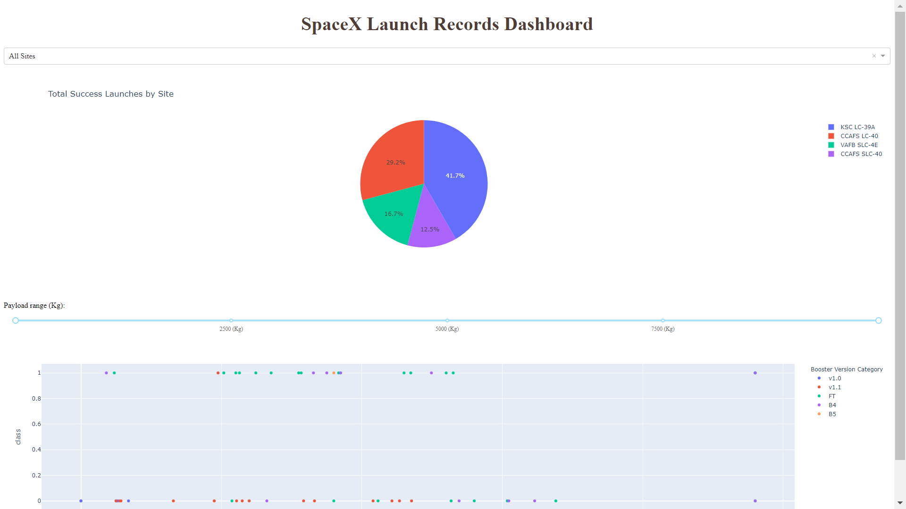
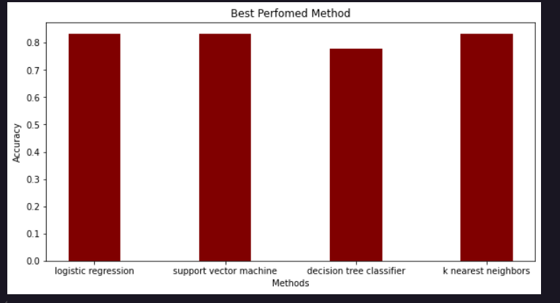
Results

Slide 17

Section 2

Slide 18
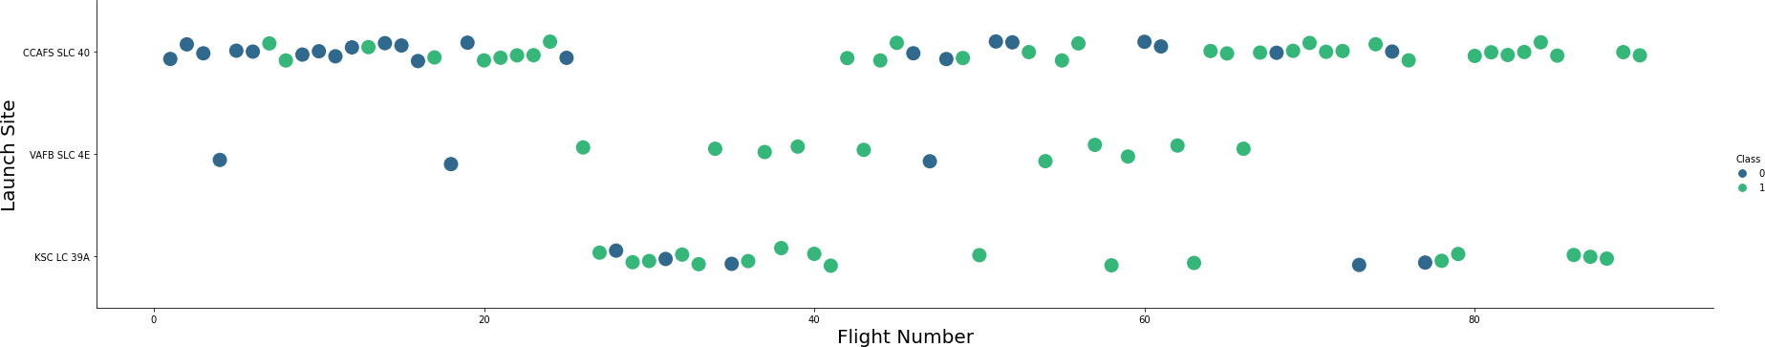
Flight Number vs. Launch Site
The graph indicates a rise in success rates over time (as indicated by Flight Number). There seems to have been a significant breakthrough around the 20th flight that notably boosted success rates. CCAFS appears to be the primary launch site, given its higher volume.

Slide 19
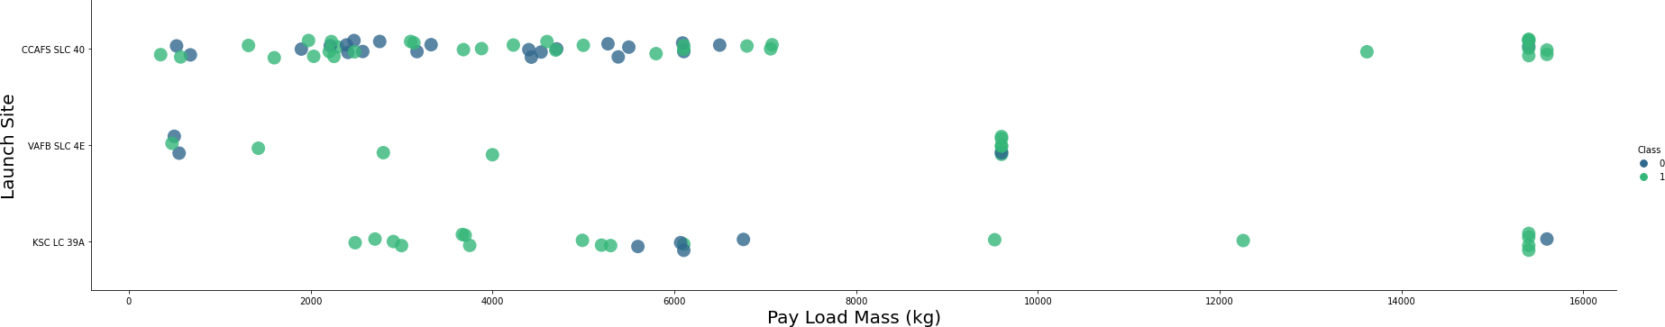
Payload vs. Launch Site
The payload mass mostly ranges between 0-6000 kg. Different launch sites also appear to handle varying payload masses.

Slide 20
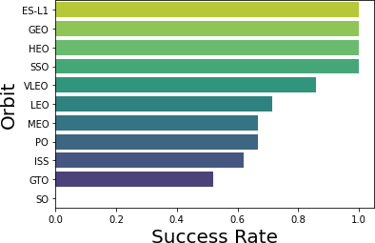
Success Rate vs. Orbit Type
ES-L1 (1), GEO (1), HEO (1) have a 100% success rate (sample sizes in parentheses). SSO (5) also boasts a 100% success rate. VLEO (14) shows a decent success rate with several attempts. SO (1) has a 0% success rate. GTO (27) exhibits around a 50% success rate and represents the largest sample size.

Slide 21
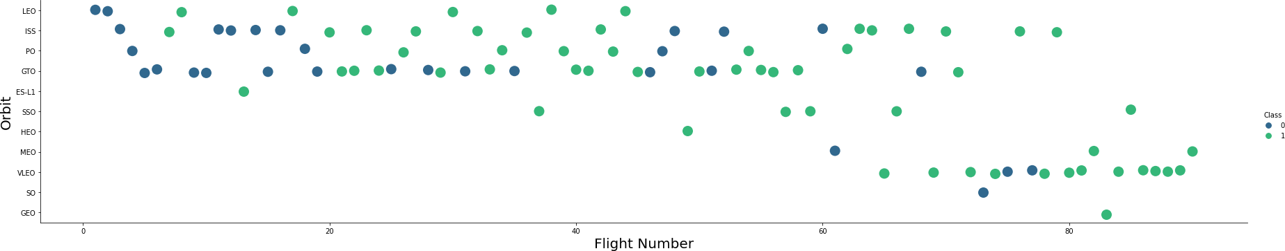
Flight Number vs. Orbit Type
Launch orbit preferences shifted over flight numbers, and launch outcomes seem to correlate with these preferences. SpaceX initially focused on LEO orbits, which saw moderate success. They then transitioned back to VLEO in recent launches. SpaceX appears to perform better in lower orbits or Sun-synchronous orbits

Slide 22
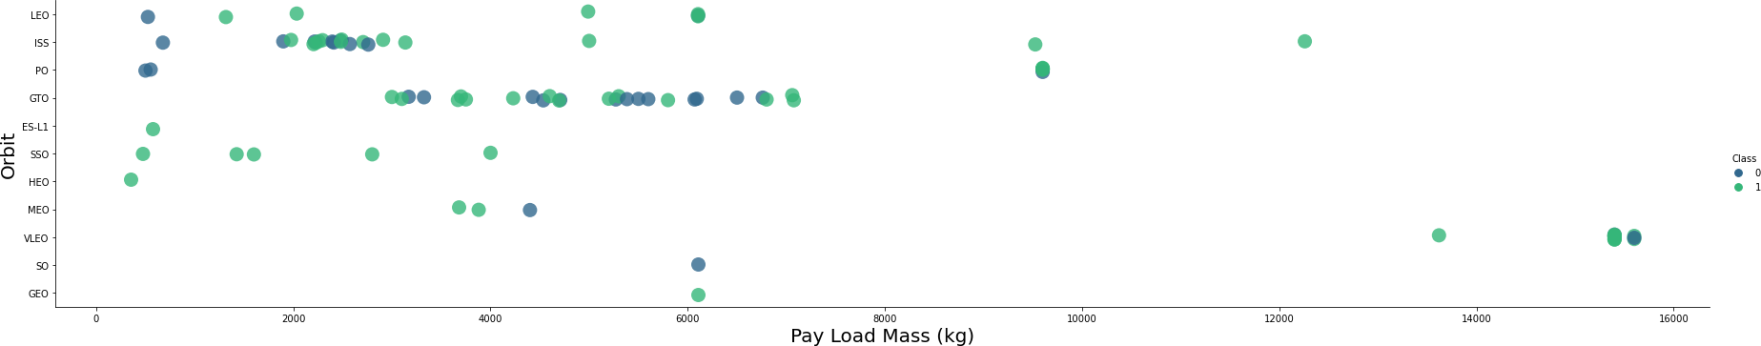
Payload vs. Orbit Type
Payload mass appears to correlate with orbit type. LEO and SSO orbits tend to have relatively low payload masses. In contrast, VLEO, which is another successful orbit, typically involves payload mass values at the higher end of the range.

Slide 23
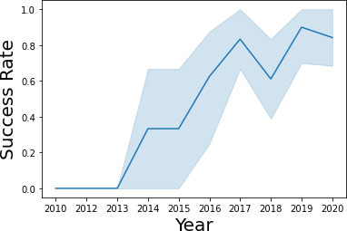
Launch Success Yearly Trend
Success rates have generally increased since 2013, with a slight dip in 2018. In recent years, success rates have stabilized around 80%.

Slide 24
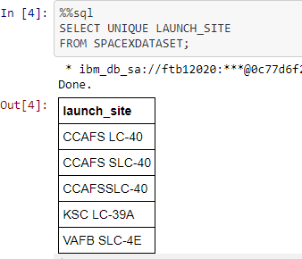
All Launch Site Names
Query unique launch site names from database.
CCAFS SLC-40 and CCAFSSLC-40 likely all represent the same
launch site with data entry errors.
CCAFS LC-40 was the previous name. Likely only 3 unique launch_site values: CCAFS SLC-40, KSC LC-39A, VAFB SLC-4E

Slide 25
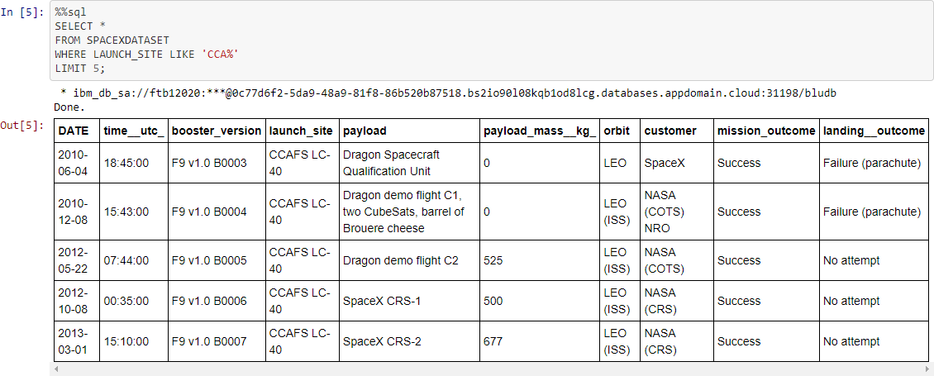
Launch Site Names Begin with 'CCA'

Slide 26
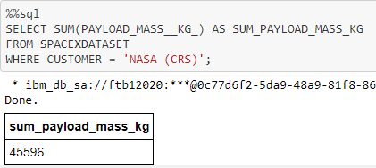
Total Payload Mass
This query sums the total payload mass in kg where NASA was the customer.
CRS stands for Commercial Resupply Services which indicates that these payloads were sent to the International Space Station (ISS).

Slide 27
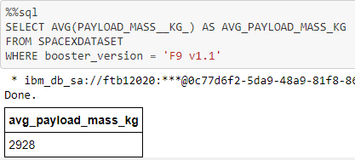
Average Payload Mass by F9 v1.1

Slide 28
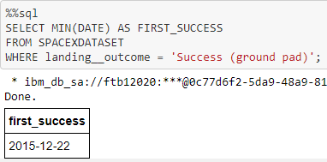
First Successful Ground Landing Date
This query returns the first successful ground pad landing date.
First ground pad landing wasn’t
until the end of 2015.
Successful landings in general
appear starting 2014

Slide 29
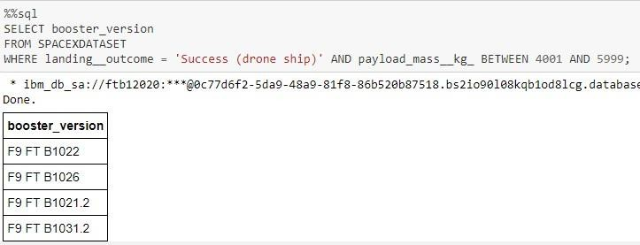
Successful Drone Ship Landing with Payload between 4000 and 6000

Slide 30
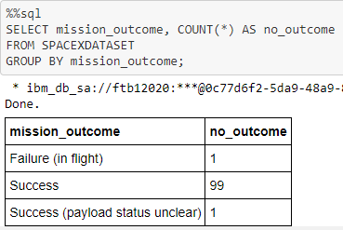
Total Number of Successful and Failure Mission Outcomes
This query provides a count of each mission outcome. SpaceX seems to achieve its mission outcomes nearly 99% of the time. This suggests that most landing failures are deliberate. Interestingly, one launch has an unclear payload status, and unfortunately, one ended in flight failure.

Slide 31
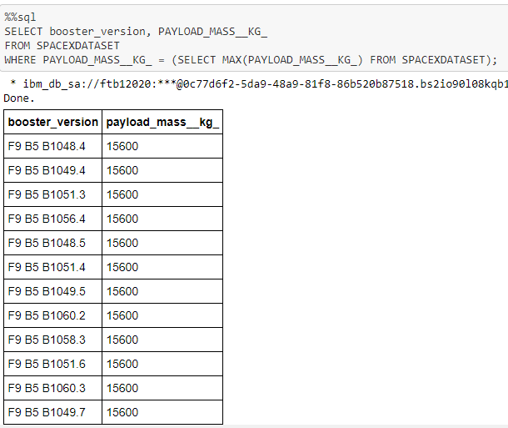
Boosters Carried Maximum Payload
This query identifies the booster versions that carried the highest payload mass of 15600 kg. These booster versions are very similar and all belong to the F9 B5 B10xx.x variety. This likely suggests that payload mass correlates with the specific booster version used.

Slide 32
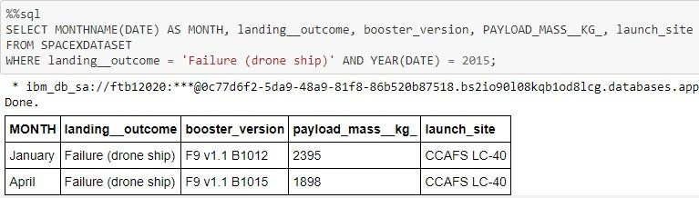
2015 Launch Records
In 2015, there were two occurrences where the first stage failed to land on a drone ship.

Slide 33
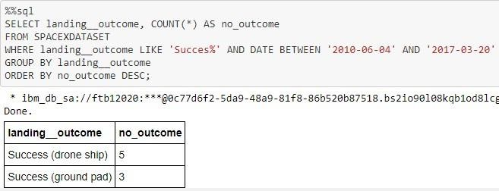
Rank Landing Outcomes Between 2010-06-04 and 2017-03-20
Between June 4, 2010, and March 20, 2017, inclusive, there were a total of 8 successful landings. These successful landings include both drone ship and ground pad landings.

Slide 34

Section 3

Slide 35

<Folium Map Screenshot 1>
The map on the left displays all launch sites relative to the US map. The map on the right specifically highlights the two Florida launch sites due to their proximity to each other. All launch sites are situated near the ocean.

Slide 36

<Folium Map Screenshot 2>
Clusters on Folium map can be clicked on to display each successful landing (green icon) and failed
landing (red icon).

Slide 37



<Folium Map Screenshot 3>

Slide 38

Section 4

Slide 39


<Dashboard Screenshot 1>
This distribution shows the successful landings across all launch sites. CCAFS LC-40, which is the old name of CCAFS SLC-40, has the same number of successful landings as KSC. However, a majority of these successful landings occurred before the name change. VAFB has the smallest share of successful landings, possibly due to a smaller sample size and increased difficulty in launching from the West Coast.

Slide 40

<Dashboard Screenshot 2>
KSC LC-39A has the highest success rate with 10 successful landings and 3 failed landings.

Slide 41

<Dashboard Screenshot 3>
The Plotly dashboard includes a payload range selector, but it's currently set from 0 to 10000 kg instead of the maximum payload of 15600 kg. The "Class" indicator uses 1 for successful landings and 0 for failures. The scatter plot also incorporates the booster version category for color and the number of launches for point size. Interestingly, within the range of 0-6000 kg, there are two instances of failed landings with payloads of zero kilograms.

Slide 42

Section 5

Slide 43

Classification Accuracy
All models achieved nearly the same accuracy on the test set, with an average of 83.33%. It's important to note that the test size is small, consisting of only 18 samples. This small sample size can lead to significant variance in accuracy results, as observed in repeated runs of the Decision Tree Classifier model. To determine the best model more reliably, additional data would likely be necessary.

Slide 44

Confusion Matrix
Since all models performed equally on the test set, the confusion matrix is identical across all models. The models correctly predicted 12 successful landings when the true label was a successful landing. They also predicted 3 unsuccessful landings when the true label was an unsuccessful landing. However, the models incorrectly predicted 3 successful landings when the true label was an unsuccessful landing (false positives), indicating that the models tend to overpredict successful landings.

Slide 45
Conclusions
Our task was to develop a machine learning model for Space Y, aiming to predict when Stage 1 will successfully land to potentially save ~$100 million USD. We utilized data from a public SpaceX API and web scraping the SpaceX Wikipedia page. After creating data labels and storing them in a DB2 SQL database, we developed a dashboard for visualization purposes. The machine learning model we created achieved an accuracy of 83%.
With this model, Allon Mask of SpaceY can predict with relatively high accuracy whether a launch will have a successful Stage 1 landing before launch. This prediction can help determine whether the launch should proceed or not.
To further enhance the model's performance, it would be beneficial to collect more data. This additional data can help refine the machine learning model selection and improve overall accuracy.

Slide 46
Appendix
Include any relevant assets like Python code snippets, SQL queries, charts, Notebook outputs, or data sets that you may have created during this project

Slide 47


